Slide 1


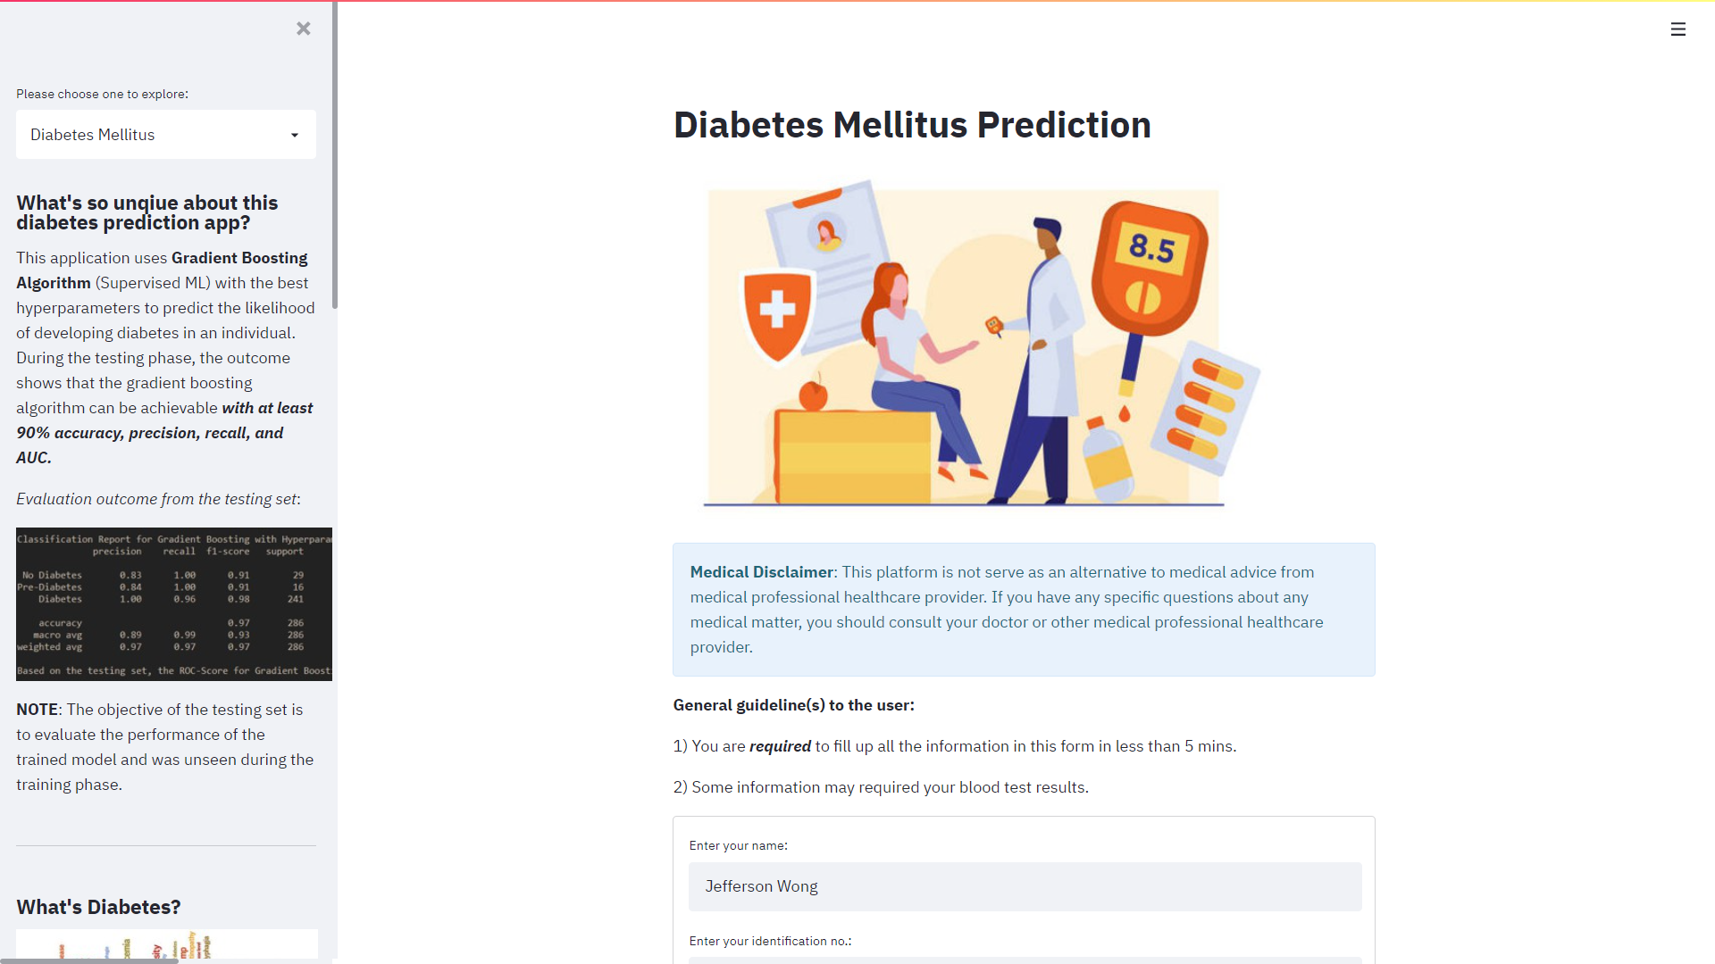
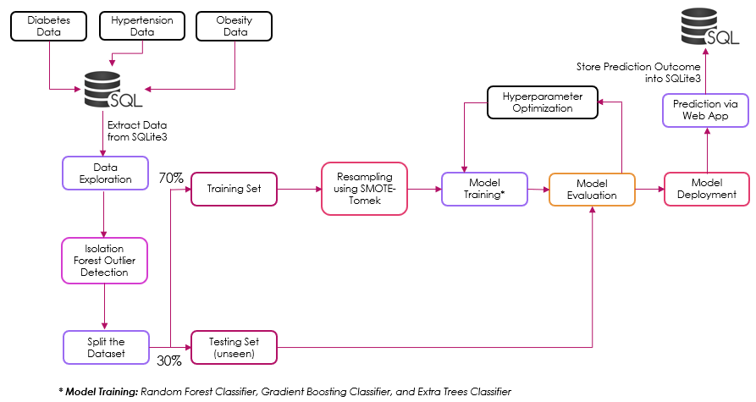
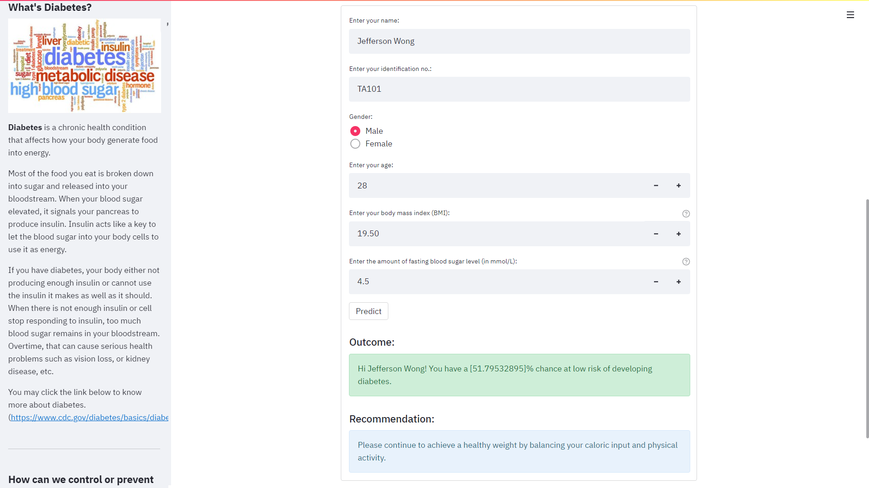
Student Name: Wong Qi Yuan, Jeffrey
Student ID: 20053371
Course: Specialist Diploma in Applied Artificial Intelligence (Intake 5)
Development of Health Web App with Integration of Ensemble Machine Learning for Early Diagnosis in Obesity-related Chronic Diseases
Project Overview
Problem:
In a recent report, the World Health Organization (WHO) mentioned that obesity-related chronic diseases have contributed to approximately about 41 million premature deaths annually, which is about 71% of all deaths worldwide. If the situation unmitigated, we are expected that the overall number of obesity-related chronic diseases related-deaths to be risen up to 52 million yearly by the end of 2030. The most common obesity-related chronic diseases are the obesity, diabetes, and hypertension.
Furthermore, we are currently now facing the crisis of the COVID-19 pandemic, hence it is expected that the number of people developing the obesity-related chronic diseases to rise as most people are working from home in order to curb the spread of the COVID-19 virus in the community. Furthermore, based on a recent news article, about 1/3 of the Singaporeans have gained weight during the COVID-19 pandemic and many people would point their fingers that at how their lifestyles have changed to become more sedentary life since the start of the COVID-19 pandemic.
Thus, it is an alarming concern in the road of the COVID-19 pandemic as obesity-related chronic diseases are more vulnerable to threat of the COVID-19. In addition, the majority of the people are unaware of their overall health status and some do not have time to go for a simple health screening.
Solution:
A user-friendly and easy-to-use web application was implemented via Streamlit to simulate the real-life practical application with the integration of the proposed classifier models (random forest, gradient boosting, extra trees) with optimized hyperparameters to predict the respective obesity-related chronic diseases such as obesity, diabetes, and hypertension such that it is offering an individual an effective and appropriate way to monitor their current health status.
How does this health web app benefit to the user?
This health web app would provide an individual to know their likelihood of being developing the obesity-related chronic diseases such as diabetes, obesity, and hypertension, and hence, reduce their time to visit the office clinic in person.
Being cost-effective as the users are able to know the diagnosis right on the spot and also provide the users the time to prevent and manage obesity-related chronic diseases by making them aware of their present condition.
Application Overview
Architecture Design of Machine Learning and Web Application
A sample web application for diabetes diagnosis

